Slide 1
Activity Diagrams
BCS 2343 Software Design Workshop

Slide 2
Activity Diagrams
Activity Diagrams consist of activities, states and transitions between activities and states
Activity Diagrams describe
how activities are coordinated to provide a service
the events needed to achieve some operation
how the events in a single use case relate to one another
how a collection of use cases coordinate to create a workflow for an organisation

Slide 3
Activity Diagrams
Model business workflows
Identify candidate use cases, through the examination of business workflows
Identify pre- and post-conditions for use cases
Model workflows between/within use cases
Model complex workflows in operations on objects
Model in detail complex activities in a high level activity diagram

Slide 4
Activity Diagrams
Activities and Actions
An activity is also called an action state
Transitions and Activity Edges
Tokens and Activity Nodes
Control Nodes
Initial and Final Nodes
Forks and Joins
Decision and Merge Points
States
Swimlanes

Slide 5
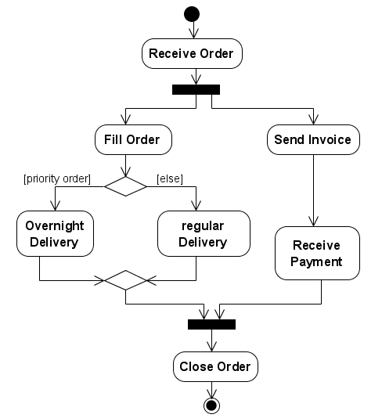
Example : Activity Diagrams

Slide 6
Activities
An Activity is the process being modelled
An Activity is a unit of work that needs to be carried out
Any Activity takes time
An activity is like a state where the criterion for leaving the state is completion of the activity.

Slide 7
Activity Edges
The flow of an activity is shown using arrowed lines called edges or paths
Control-flow Transitions indicate the order of action states
Object-flow Transitions indicate that an action state inputs or outputs an object

Slide 8
Tokens
Conceptually, UML models information moving along an edge as a token (e.g., real data, an object or focus of control)
Each edge may have
a weight associated with it that indicates how many tokens must be available before the tokens are presented to the target action
a guard condition (is enclosed in brackets) [guardname]

Slide 9
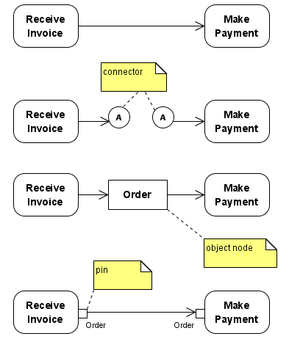
Flows and Edges

Slide 10
Decision Points
To implement in the large diagram which have a lot of different conditions
Using the notation of diamond.
To separated the activities if the there have condition to implement

Slide 11
Example:Decision Points

Slide 12
Activity Nodes
UML 2.0 defines several types of activity nodes to model different types of information flow
Object nodes
(Input or output) Pins – Special notation for object nodes
Represented by a small rectangles on the side of an action
Input pin – represent the data input to the activities
Output pin - represent the data output from the activities

Slide 13
Initial and Final Nodes
An initial node is the starting point for an activity
Two types of final nodes: activity final and flow final
An activity final node terminates the entire activity
A flow final node terminates a path through an activity, but not the entire activity
Only one initial nodes are allow in a activities.
It is possible to have multiple final nodes

Slide 14
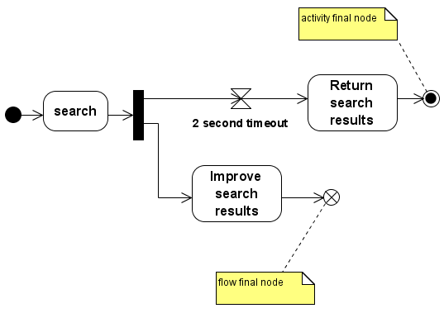
Final Nodes

Slide 15
Forks
A transition can be split into multiple paths and multiple paths combined into a single transitions by using a synchronisation bar
A synchronisation may have many in-arcs from activities and a number of out-arcs to activities
A fork is where the paths split
On an occurrence of the transition all the activities with arcs from the transition are initiated
A fork node splits the current flow through an activity into multiple concurrent flows

Slide 16
Example : Forks

Slide 17
Joins
A join is where the paths meet
The bar represents synchronisation of the completion of those activities with arcs into the transition
A join synchronises multiple flows of an activity back to a single flow of execution

Slide 18
Example : Joins

Slide 19
Swimlanes
Swimlanes (or activity partitions) indicate where activities take place.
Swimlanes can also be used to identify areas at the technology level where activities are carried out
Swimlanes allow the partition an activity diagram so that parts of it appear in the swimlanes relevant to that element in the partition

Slide 20
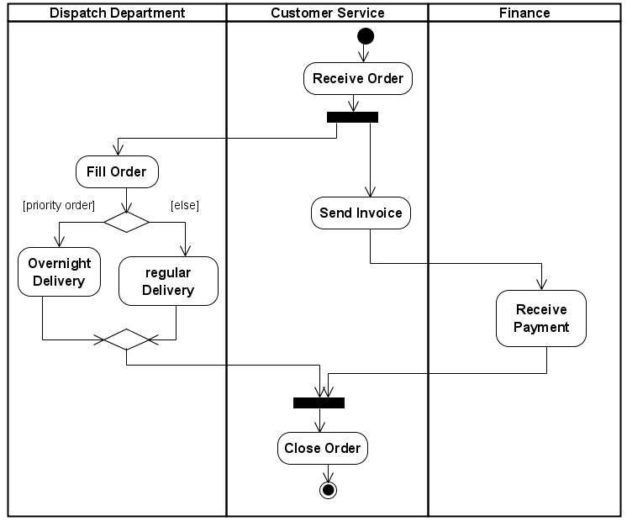
Example : Swinlanes

Slide 21
How to construct Activity Diagrams
1. Finding system Actors, Classes and use cases
2. Identifying key scenarios of system use cases
3. Combining the scenarios to produce comprehensive workflows described using activity diagrams
4. Where significant object behaviour is triggered by a workflow, adding object flows to the diagrams
5. Where workflows cross technology boundaries, using swimlanes to map the activities
6. Refining complicated high level activities similarly, nested activity diagrams

